Slide 1
Submission to Tauranga City Council’s Long term plan 7th May 2018 Submission ID:1060A
Andrew von Dadelszen

Slide 2
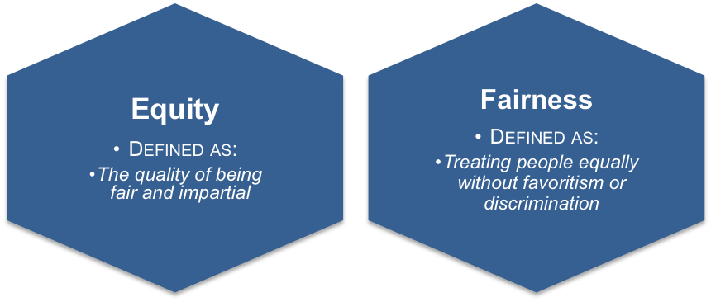
Rates structure - UAGC I SUPPORT OPTION 1 – status quo
Retaining the 30% UAGC is the fairest solution
This ensures that all properties pay for the core services
Andrew von Dadelszen

Slide 3
Rates - commercial DIFFERENTIAL I SUPPORT OPTION 2
Be careful not to kill commerce – encourage it
All ratepayers benefit from better facilities
1 to 1.2 is acceptable – but no more
Andrew von Dadelszen

Slide 4
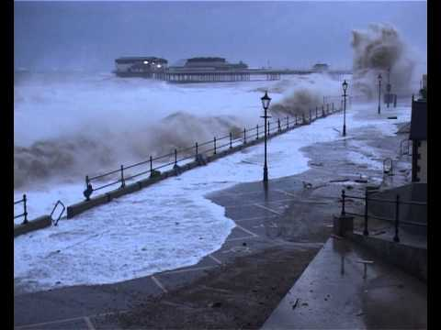
Funding Resilience I SUPPORT OPTION 2 – Targeted rate
Residents choose to buy vulnerable properties
“Let the buyer beware” – target at risk properties
All ratepayers should pay for core services
Andrew von Dadelszen

Slide 5
Inner City Targeted Rate I SUPPORT OPTION 1 – status Quo
Don’t penalise inner city living – encourage it
All ratepayers will utilitse a vibrant CBD
Getting people our of cars will benefit everyone
Andrew von Dadelszen

Slide 6
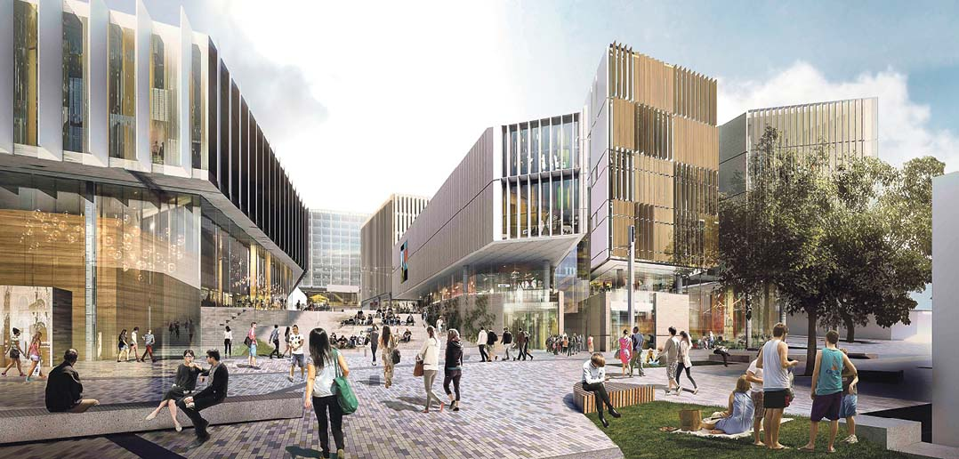
I strongly support the Revitalisation of our CBD
GET ON WITH IT – Give certainty
BE BOLD - you were voted in to do this
Defeat the NAYSAYERS– Make the hard decisions
Andrew von Dadelszen

Slide 7
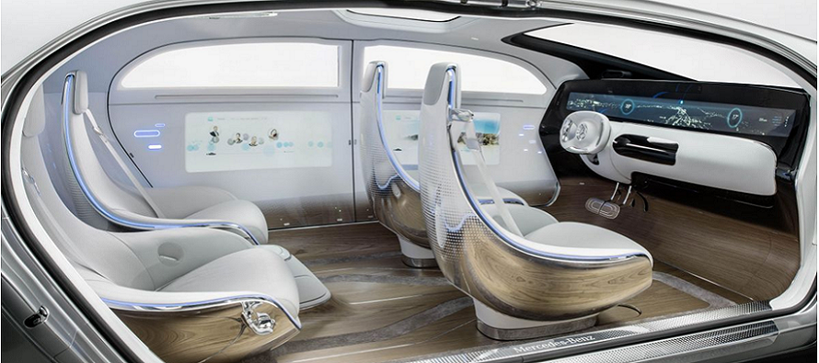
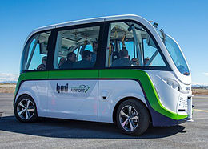
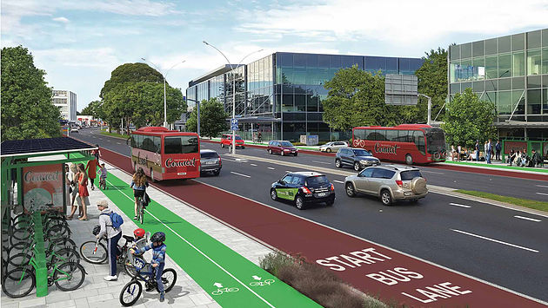
Transport network I SUPPORT OPTION 2 – Increased choices
Build appropriate infrastructure to ensure traffic flow
T3/Bus lanes are essential (but only at peak times)
Facilitate Technological Solutions – autonomous cars/buses
Andrew von Dadelszen

Slide 8
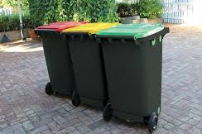
Kerbside waste
Base your decision on sound economic fundamentals
Stop annoying ratepayers – it’s not rocket science
An interim glass-only solution is needed
Andrew von Dadelszen

Slide 9
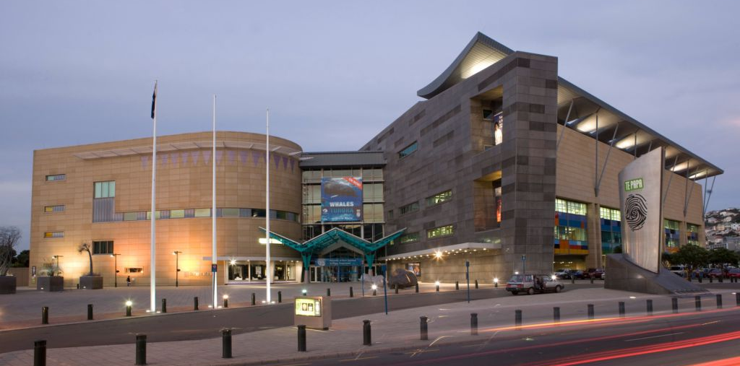
Museum I SUPPORT OPTION 1 – but not Cliff road
Must be in a revitalised CBD
Allocate a maximum of $10m of rate funding
I question the need to rebuild the library right now
Andrew von Dadelszen

Slide 10
Tourism BOP
Tourism BOP needs to prove it is genuinely adding value
Its track record is poor
Andrew von Dadelszen

Slide 11
I strongly support Environmental sustainability
Encourage inner city green space
I strongly support a “Predator Free” city
The revitalisation of the Kopurererua Valley Wetland Restoration – currently too slow
Andrew von Dadelszen

Slide 12
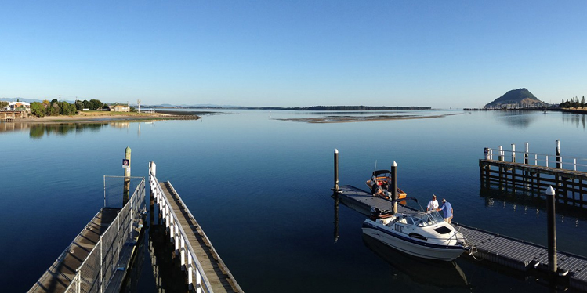
I strongly support Coastal Marine Research Institute
We must not lose this Research Institute
We must not lose Prof. Chris Battershill
Select the old BMX track site on Sulphur Point
Andrew von Dadelszen

Slide 13
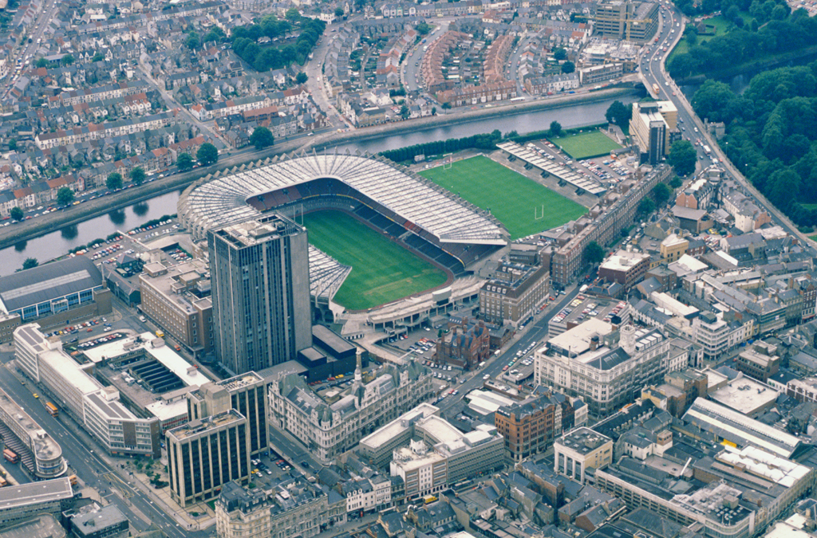
I strongly support Stadium on the Domain
From 2016 submission
Maximise the CBD Benefit – no parking needed
This is an integral part of your CBD Redevelopment
Andrew von Dadelszen

Slide 14
OWNERSHIP Issues Don’t build monuments
From 2016 submission
Build and Lease back – don’t own
Retain Capex for growth infrastructure
Sell your Parking Buildings – not core assets
Protect your Balance Sheet
Andrew von Dadelszen

Slide 15
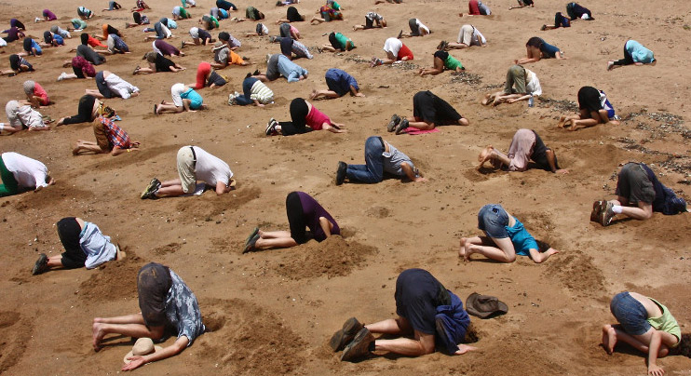
This is a “Once in a generation” opportunity You still seem to want to miss it
Andrew von Dadelszen

